Slide 1
Semiconductor Solutions Challenge 2026
THE PROBLEM WE SOLVE
Problem D:
Physics-Based Machine Learning Model for Static Voltage Drop Prediction
Power integrity at advanced VLSI nodes
Resistive PDN losses create static IR (voltage) drop that degrades chip performance, causes timing failures, and reduces reliability.
Signoff analysis runs too late
Conventional GV=J solvers (hours runtime) are used at design closure. IR issues found late cost 10× more to fix than early-stage.
Team RAV
School of Computing and Augmented Intelligence Arizona State University
ML enables early-stage hotspot prediction
Fast ML inference (~1 sec) during placement & routing identifies IR hotspots early, enabling proactive, low-cost design optimization.
Our contribution: physics-informed model
A 31-feature linear model derived from IR drop physics, achieving 0.23 mV MAE and F1=0.70 on hidden real-circuit test cases.
March 2026
1

Slide 2
Team RAV | Arizona State University | Semiconductor Solutions Challenge 2026
Motivation: Static IR Drop in Power Delivery Networks
What is Static IR Drop?
Why It Matters
IR drop is the voltage loss across resistive PDN wires between the power supply pads and circuit cells, governed by Ohm's Law:
Timing failures
Local Vdd reduction slows gate switching below spec
ΔV = I × R → GV = J
G = PDN conductance matrix | V = node voltages | J = cell current demands
Logic errors
Three factors drive IR drop:
Worst-case drops flip state — functional failures
Current density J(x,y)
Reliability degradation
High-demand cells draw more current
Thermal stress from underpowered cells shortens chip life
PDN density ρ(x,y)
Sparse grid = higher effective resistance
Costly design respins
Distance to supply d(x,y)
IR issues found at signoff require expensive ECOs
Farther pads = longer, more resistive path
Challenge: solving GV=J has billions of variables — computationally intractable for fast design iteration.
Industry context: Signoff IR analysis typically runs once, late in design closure — when fixing violations costs 10× more than early-stage mitigation. ML-based prediction during placement and routing shifts this to a proactive workflow.
2

Slide 3
Team RAV | Arizona State University | Semiconductor Solutions Challenge 2026
Existing Methods: From Simulation to Machine Learning
State of the art and its limitations
SPICE / GV=J Simulation
CNN / U-Net (Image models)
XGBoost (Tree-based)
IREDGe / AttUNet (SOTA 2023-24)
• Exact solution guaranteed
• Maps IR drop as image translation
• Per-pixel gradient boosting
• F1=0.456 (IREDGe), 0.520 (AttUNet)
• Scales to billions of nodes
• GPU training required
• Good MAE, poor hotspot F1
• MAE~0.11 mV (AttUNet)
• Runtime: hours per design
• Black-box: no interpretability
• No physical inductive bias
• Large model, GPU required
• Unusable for early-stage
• Hard to transfer to new nodes
• ~90 min GPU training time
• Complex architecture
Exact but far too slow
Fast inference, opaque
Accurate, slow to train
Best published results
Our approach: Physics-inspired linear model — interpretable, fast to train on CPU, competitive accuracy without GPU inference
3

Slide 4
Team RAV | Arizona State University | Semiconductor Solutions Challenge 2026
Our Approach: Why a Physics-Informed Linear Model?
Explainability, simplicity, and competitive performance without deep learning
Advantages Over Black-Box ML
Connecting Physics to Provided Features
Fully explainable
The ICCAD dataset provides exactly the three IR-drop drivers:
Every coefficient maps to a physical quantity. ‘For instance; This hotspot is driven by vertical current in sparse PDN.’
current_map.csv
→ J(x,y)
Cell current demand — the source of IR drop
No GPU required
Training via Weighted Least Squares (BVLS) in ~7 min total on standard CPU. Inference in < 1 sec per map.
pdn_density.csv
→ ρ(x,y)
PDN wire density — resistance proxy
Auto-feature selection
BVLS non-negativity constraint prunes 18 of 31 features to zero — only physically relevant terms gets activated.
eff_dist_map.csv
→ d(x,y)
Distance to nearest voltage source pad
Robust to small data
Only 31 parameters to fit; 4-11M training rows is 1000× overdetermined.
No overfitting.
Model design principle:
We begin with Ohm’s Law ΔV = J·R,
We, then engineer features that approximate R_eff(x,y) using ρ and d in various combinations and spatial scales.
EDA-flow compatible
Model is a simple dot product — can run inside EDA tools without GPU or DL framework dependencies.
ΔV̂(x,y) = Σ a_k · Φ_k(J, ρ, d) × s*
All a_k ≥ 0 (physically constrained)
4

Slide 5
Team RAV | Arizona State University | Semiconductor Solutions Challenge 2026
Feature Library: Physics-Derived 31-Feature Basis
Every feature motivated by IR drop physics — BVLS solver auto-selects the relevant ones
Model: ΔV̂(x,y) = Σ a_k · Φ_k(J(x,y), ρ(x,y), d(x,y)) × s* with a_k ≥ 0 (BVLS non-negativity constraint)
Isotropic Gaussian Blurs
PDN Interactions (c×p̃, p̃×d, etc.)
Anisotropic Blurs
Diff. of Gaussians (DoG)
Anisotropic × PDN Interaction
J * G_σ σ∈{1,2,4,8,16,32,50,75,100}px
c×p̃, p̃×d, p̃/d r/p̃, 1/(d·p̃)
J * G_(σv,σh) 7 pairs, vertical-dominant
max(0, J*G_50 - J*G_20) 2 pairs
J̃_(50v,10h)×p̃ J̃_(50v,25h)×p̃
9 features
6 features
7 features
2 features
2 features
Spatial averaging of current demand at multiple scales approximates the PDN resistance catchment area at each location.
Multiplicative cross-terms model compound effects: high current demand AND low PDN density AND far from supply = worst hotspot.
PDN metal layers run vertically. IR drop spreads in stripe patterns. Anisotropic Gaussians capture this directional structure.
Local current elevation above background average. A direct hotspot detector: high DoG = current spike above neighborhood mean.
Joint condition: vertical current demand in sparse PDN region. The #1 feature in XGBoost (32.6% gain) and largest coefficient here.
31 total features • 13 active after BVLS (18 auto-pruned to zero) • Training: ~7 min on CPU • Inference: < 1 sec per map
5

Slide 6
Team RAV | Arizona State University | Semiconductor Solutions Challenge 2026
Feature Engineering: Physical Intuition & Key Results
Each feature group is grounded in PDN physics; solver determines which terms carry real signal
Feature Group
Physical Motivation
Discovered Result
Isotropic Blurs J̃_σ (9 scales)
Blur radius approximates PDN resistance catchment area. Wider blur = longer-range current influence on IR drop.
J̃_100px dominant at long range. J̃_2,4px capture local peaks. J̃_50px zero (covered by anisotropic).
PDN Interactions c×p̃, p̃×d, p̃/d, d/p̃, 1/(d·p̃)
PDN density modulates local resistance. Low density = high resistance per unit length. Cross-terms capture compound effects.
5 of 6 interaction terms activated. F1 improved 5.6× over baseline (0.018 → 0.10) when interactions added.
Anisotropic Blurs (7 pairs, vertical-dominant)
PDN stripes run vertically. IR drop spreads in stripe patterns, visible in all ground truth maps.
Horizontal blurs zero out. J̃_(100v,10h) is dominant. Physics confirms: PDN metal layer routing is primarily vertical.
Diff. of Gaussians max(0, J̃_50-J̃_20)
A hotspot = local current elevation above neighborhood average. DoG is a direct spatial spike detector.
DoG_(50-20) activates. DoG_(50-8) zeros out — 8px is too local. Critical for pushing peak predictions above threshold.
Anisotropic × PDN J̃_(v,h)×p̃
Worst IR drop: high vertical current AND sparse PDN AND far from pads. Product feature captures this joint condition.
Largest coefficient (4226): J̃_(50v,25h)×p̃. Also #1 in XGBoost (32.6% gain). Validated across both models.
6

Slide 7
Team RAV | Arizona State University | Semiconductor Solutions Challenge 2026
Training: Weighted Least Squares with Physical Constraints
Non-negative BVLS ensures physically valid coefficients; real-circuit data is prioritized 10×
Training Formulation
Data & Computational Setup
Objective — Weighted Least Squares (BVLS):
min_{a≥0} ‖ W·(Φa - ΔV) ‖² subject to: a ≥ 0
Training: real maps
10 (testcase1–18, seen)
Training: synthetic maps
100 (BeGAN-generated)
Non-negativity (BVLS)
Hidden test maps
10 (testcase7–20, unseen)
IR drop increases with current demand — all terms must contribute positively. Enforces physical validity.
Features (total / active)
31 / 13 (18 auto-pruned)
Sample weighting W
Design matrix
~11.7M rows × 31 cols
Real circuit maps weighted 10× vs. 100 synthetic maps. Model adapts to real chip distributions.
RAM (design matrix)
~2.9 GB
Solver
SciPy lsq_linear (BVLS)
Pixel subsampling
10-20% subsampling on synthetic maps: 44M → 11M rows. Accuracy unchanged (31 unknowns, 11M equations).
Feature precompute
~200 sec (990 Gaussian filters)
Solve time
~67 sec
Global scale s*
Inference per map
< 1 sec (numpy dot product)
Post-fit: s* = Σ(GT) / Σ(pred) across training maps. Corrects systematic underestimation bias. s*=1.008 confirms model calibration.
Model checkpoint size
31 coefficients ≈ 248 bytes
Per-feature normalization
Hardware
AMD Ryzen 9 5900HX, 16 GB RAM
Design matrix columns divided by standard deviation. Ensures BVLS solver doesn’t favor high-magnitude features.
7

Slide 8
Team RAV | Arizona State University | Semiconductor Solutions Challenge 2026
Recovered Model
13 of 31 features activate — each maps directly to a physical IR drop driver
Recovered equation (active terms, s*=1.008 applied):
ΔV̂ = 3.3e-5 + 337·J̃₂ + 438·J̃₄ + 6488·J̃₁₀₀ + 1.3e-6/ρ + 8.7(c·p̃) + 5.5e-7(p̃·d) + 1.8e-11(p̃/d) + 5.0e-7(d/p̃) + 5.9e-12/(d·p̃) + 1869·J̃₍₁₀₀v,₁₀h₎ + 507·J̃₍₃₀v,₅h₎ + 396·DoG + 1449·J̃₍₅₀v,₁₀h₎·p̃ + 4226·J̃₍₅₀v,₂₅h₎·p̃
Active Coefficients
Value
Physical Role
Physical Interpretations
bias
3.3×10⁻⁵
Baseline offset
Vertical anisotropy is real
J̃_2px, J̃_4px
337, 438
Local current peaks
Both winning aniso features have σ_vertical >> σ_horizontal. All horizontal-dominant blurs zero out. PDN metal routing creates vertical stripe hotspot structure.
J̃_100px
6488
Long-range current field
PDN_r (1/ρ)
1.3×10⁻⁶
Direct PDN resistance
Interaction terms dominate
c×p̃
8.7
Current×PDN interaction
J̃_(50v,25h)×p̃ (coeff 4226) is 6× larger than pure current blurs. The product of vertical current in the sparse PDN is the strongest single predictor.
p̃×d
5.5×10⁻⁷
PDN×distance
p̃/d, d/p̃, 1/(d·p̃)
various
Distance-PDN cross terms
J̃_(100v,10h)
1869
Strong vertical current
Auto-sparsity is informative
18 pruned features reveal what does NOT matter: J̃_50px, J̃_75px, horizontal blurs. The solver independently discovered the vertical PDN structure.
J̃_(30v,5h)
507
Medium vertical burst
DoG_(50-20px)
396
Local current hotspot
J̃_(50v,10h)×p̃
1449
Aniso×PDN interaction
s*=1.008 signals calibration
J̃_(50v,25h)×p̃
4226 (largest)
Primary hotspot driver
Near-unity scale (vs. 1.09 in earlier models) confirms the richer feature set corrected systematic underprediction bias. Model is well-calibrated.
8

Slide 9
Team RAV | Arizona State University | Semiconductor Solutions Challenge 2026
Data: Dataset Structure, Preprocessing & Training Setup
100 synthetic + 10 real training maps; 10 hidden real-circuit test maps for evaluation
Dataset Overview
Preprocessing Pipeline
Synthetic maps (100)
1. Feature extraction
Generated by BeGAN (GAN-based power grid synthesis). Varied current distributions, PDN densities, pad locations. Used to augment real-circuit training.
Apply 9 isotropic + 7 anisotropic Gaussian filters to current map. Compute 6 PDN interaction terms and 2 DoG features per map.
2. PDN smoothing
Real training maps (10)
Raw PDN is step-function over rectangular blocks. Blur with σ=20px to smooth boundaries and prevent block artifacts in predictions.
Actual chip layout data: testcase1-6, 11, 12, 17, 18. Map sizes 204×204 to 930×930 pixels. IR range: 0.12 to 5.90 mV.
3. Column normalization
Hidden test maps (10)
Divide each design matrix column by its standard deviation across all training maps. Ensures equal solver sensitivity.
testcase7-10, 13-16, 19, 20. Unseen real circuits, 257×257 to 870×870 pixels. Ground truth withheld during training.
4. Pixel subsampling
Sample 10-20% of pixels from each synthetic map to reduce RAM. All real-circuit pixels kept. Result: ~11.7M rows (from 44.9M).
Input format
Three CSV maps per testcase: current_map.csv, pdn_density.csv, eff_dist_map.csv. Each pixel = 1μm×1μm region.
5. Sample weighting
Real-circuit rows weighted 10× in the WLS objective. Synthetic data augments but does not dominate the real-circuit signal.
9

Slide 10
Team RAV | Arizona State University | Semiconductor Solutions Challenge 2026
Evaluation Metrics & Model Selection
F1 score (90th percentile of GT) and MAE guide model improvement across feature iterations
Evaluation Metrics
Model Improvement: Feature Ablation
Mean Absolute Error (MAE) — 60% weight
Model Version
MAE
F1
Key Change
MAE = (1/N) Σ | ΔV̂(x,y) − ΔV(x,y) |
Baseline (14 feat)
Isotropic blurs + distance + PDN_r
Average per-pixel voltage prediction error in mV. Lower is better.
0.494
0.437
F1 Score — Hotspot detection, 30% weight
Hotspot threshold: 90th percentile of ground truth IR drop values per testcase.
+ PDN smoothing (blurred PDN)
Smooth PDN prevents block artifacts
0.459
0.496
F1 = 2·Precision·Recall / (Precision + Recall) Positive class: pixels with ΔV > 90th percentile of GT
+ Anisotropic (4 pairs added)
Vertical stripe structure captured
Higher is better. Rewards correctly identifying the most severe IR drop regions.
0.447
0.521
Runtime — 10% weight
Inference time per design. Our model: < 1 sec (numpy dot product). No GPU required.
+ Full library (31 features)
Aniso×PDN + DoG = largest gain
Score = 0.60×MAE + 0.30×F1 + 0.10×Runtime (relative scoring per testcase)
0.227
0.704
Key insight: Removing J̃_50px (Spearman r=0.83) degrades MAE only 0.4%. Adjacent blur scales compensate for the drop while interaction terms drive F1 improvement.
10

Slide 11
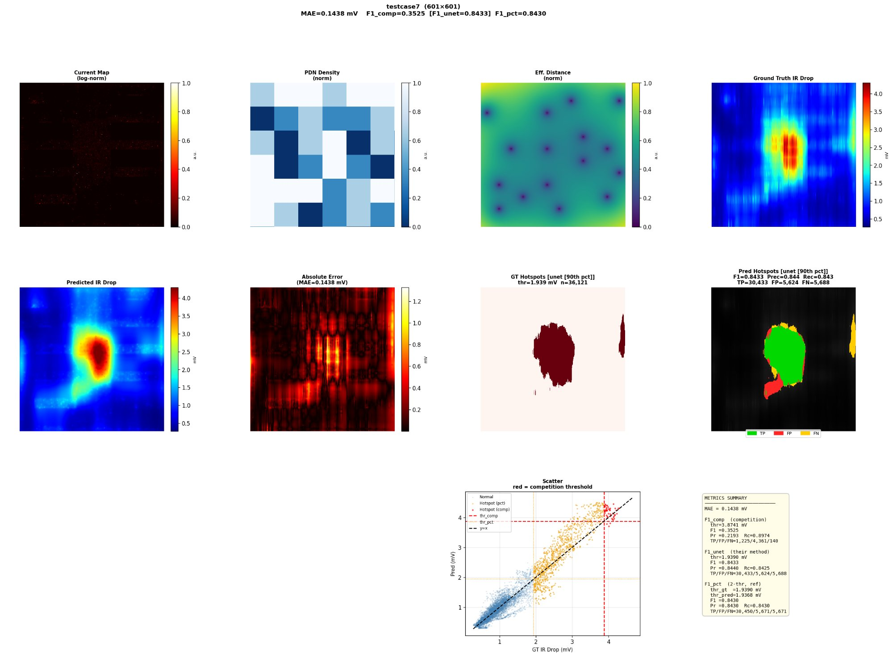
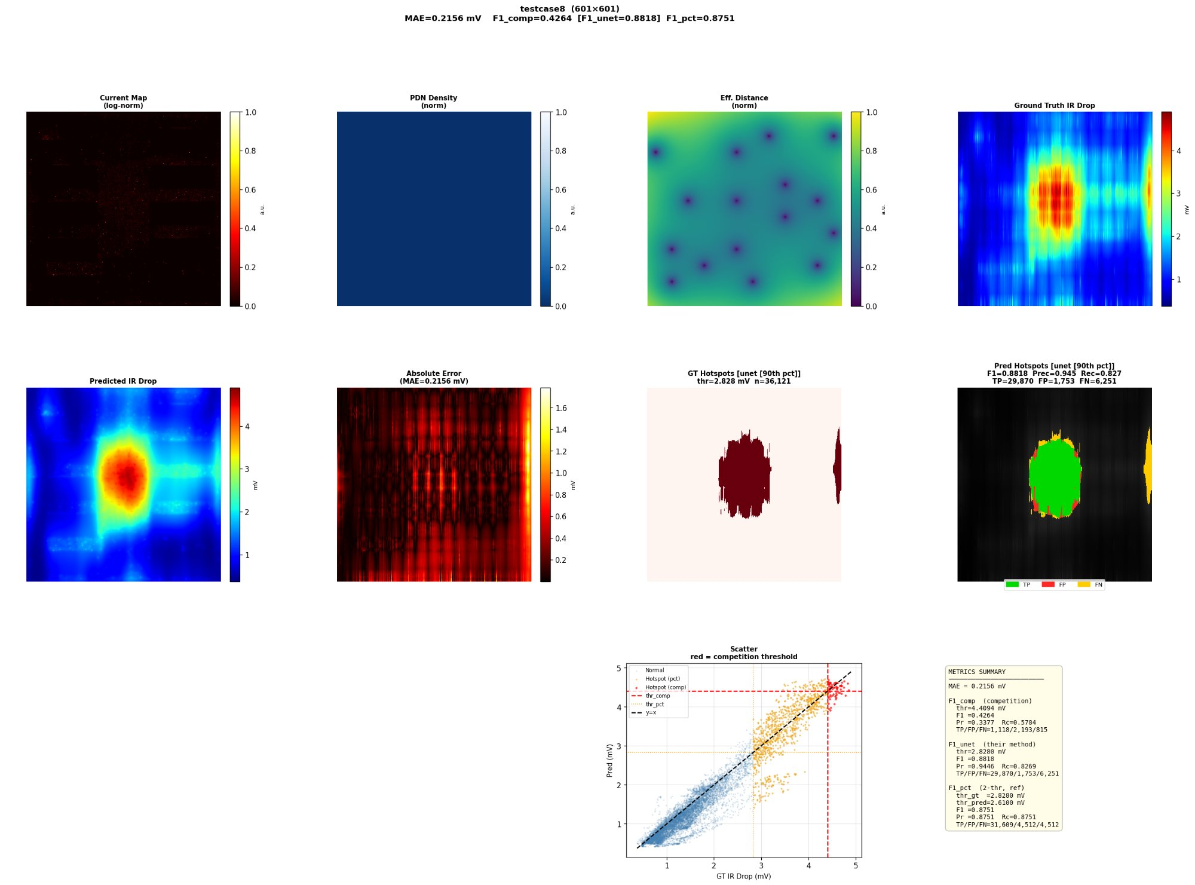
Team RAV | Arizona State University | Semiconductor Solutions Challenge 2026
Prediction Quality: Visual Comparison on Best Cases
Predicted IR drop maps closely match ground truth — vertical stripe patterns correctly recovered
testcase7 (601×601) — MAE = 0.144 mV | F1 = 0.843
testcase8 (601×601) — MAE = 0.216 mV | F1 = 0.882
Observations:
• Vertical stripe hotspot structure in ground truth (top-right) is correctly recovered by predicted maps (middle-left)
• Predicted and GT maps show strong spatial alignment — hotspot location, shape, and magnitude all well captured
• Error concentrated at PDN stripe boundaries — model identifies hotspot locations but slightly underestimates extreme peak magnitudes
• testcase8 (uniform PDN, single density) achieves best results; testcase7 (multi-region PDN) captures more complex spatial patterns
11

Slide 12
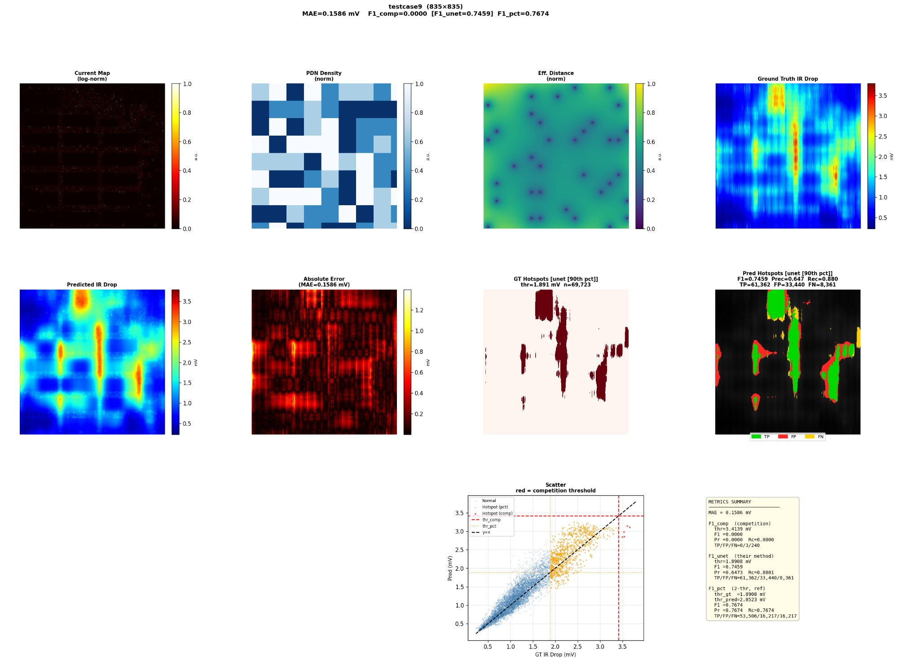
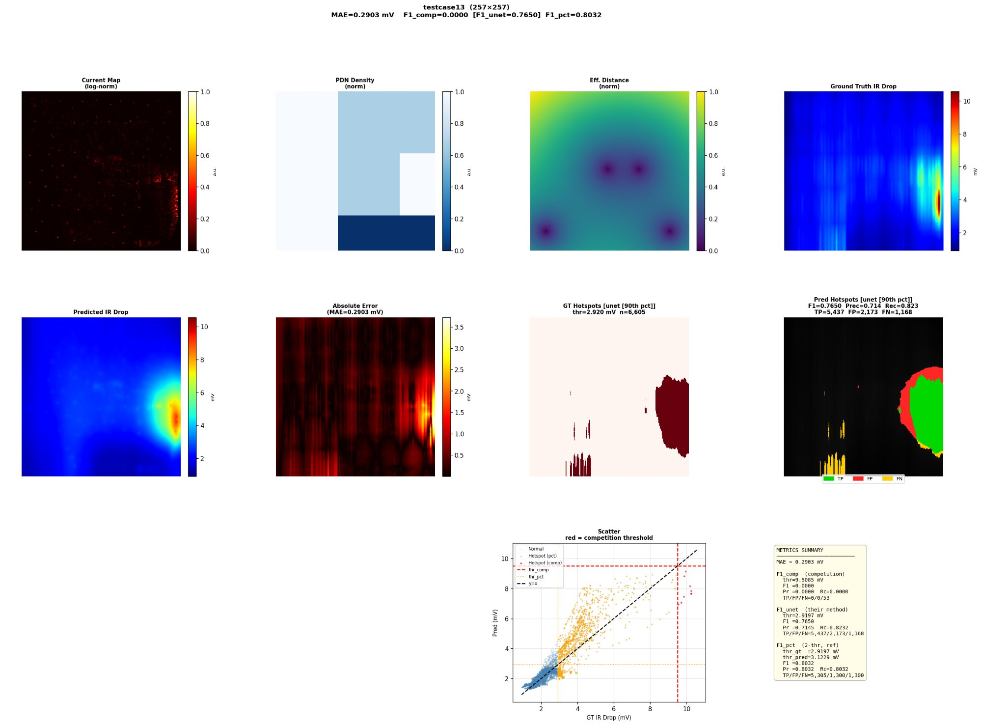
Team RAV | Arizona State University | Semiconductor Solutions Challenge 2026
Prediction Quality: Challenging Test Scenarios
Non-uniform PDN and extreme peaks present difficulty — spatial structure still well-captured
testcase9 (835×835) — MAE = 0.159 mV | F1 = 0.746
testcase13 (257×257) — MAE = 0.290 mV | F1 = 0.765
Observations:
• testcase9: complex multi-region PDN — model captures dominant hotspot clusters but misses isolated high-drop columns at extreme competition threshold
• testcase13: non-uniform PDN with extreme peak (~10 mV) — predicted map correctly locates hotspot region (right edge) but underestimates absolute peak magnitude
• Competition F1 (0.9×max) is very strict — only 240-825 pixels qualify on these large maps; sensitive to peak calibration accuracy
• Future work: hotspot-weighted training loss will directly optimize peak prediction; ensemble with XGBoost further improves F1
12

Slide 13
Team RAV | Arizona State University | Semiconductor Solutions Challenge 2026
Results: Performance on 10 Hidden Test Cases
Physics model achieves 0.23 mV MAE and F1=0.70 on unseen real-circuit designs
0.23 mV
0.70
< 1 sec
31
248 B
Mean MAE (10 hidden cases)
Mean F1 (90th pct threshold)
Inference per map
Model parameters
Model size
Test Case
Map Size
MAE (mV)
F1
F1_comp
F1_pct
Observation
testcase7
601×601
0.144
0.843
0.353
0.843
Best F1 — single density PDN, clear hotspot
testcase8
601×601
0.216
0.882
0.426
0.875
Best overall — uniform PDN, strong comp F1
testcase9
835×835
0.159
0.746
0.000
0.767
Good F1; competition threshold very strict
testcase10
835×835
0.195
0.671
0.000
0.715
Uniform PDN; spatial structure well captured
testcase13
257×257
0.290
0.765
0.000
0.803
Non-uniform PDN; strong F1 despite peak gap
testcase14
489×489
0.405
0.836
0.000
0.865
Strong F1; MAE slightly elevated
testcase15
489×489
0.342
0.551
0.154
0.459
Multi-region PDN; most challenging case
testcase16
489×489
0.366
0.246
0.000
0.619
Uniform PDN; extreme max drop (>6 mV)
testcase19
870×870
0.082
0.665
0.069
0.732
Lowest MAE (0.082 mV) — excellent
testcase20
489×489
0.057
0.838
0.000
0.840
Best MAE (0.057 mV) in entire test set
MEAN
—
0.226
0.704
0.100
0.752
Published benchmarks (ICCAD 2023, real circuits): IREDGe — MAE ~0.456 mV, F1 ~0.456 | AttUNet — MAE ~0.110 mV, F1 ~0.520
13

Slide 14
Team RAV | Arizona State University | Semiconductor Solutions Challenge 2026
Further Results: Ablation Study & Cross-Model Validation
Physics-informed features validated independently by both linear model and XGBoost
Feature Ablation Study
All-Model Comparison
Configuration
MAE
F1
F1_pct
Model
MAE
F1
Train
GPU
Baseline (14 feat)
0.494
0.437
0.639
IREDGe (ICCAD 2023)
~0.456
0.456
Hours
Required
+ Blurred PDN σ=20
0.459
0.496
0.668
AttUNet (2024 SOTA)
~0.110
0.520
Hours
Required
+ 4 anisotropic blurs
0.447
0.521
0.715
XGBoost v2 (15 feat)
0.289
0.546
~90 min
Required
Ablate J̃_50px only
0.461
0.497
0.667
XGBoost v3 (26 feat)
0.243
0.619
~9 min
Required
+ 7 anisotropic blur + DoG + ×PDN (31 features, BEST)
0.227
0.704
0.752
Physics model (31 feat) BEST
0.227
0.704
~7 min
Not needed
Best model, no scale s*
0.234
0.669
0.756
Ablation finding: Removing J̃_50px (highest Spearman r=0.83 with IR drop) degrades MAE by only 0.4%. The blur bank provides redundant coverage — adjacent scales compensate. The interaction terms (c×p̃, aniso×PDN) drive the majority of F1 improvement.
Strengths:
✓ Best hidden-test MAE (0.227 mV) of all approaches ✓ Best F1 (0.704) among non-GPU methods ✓ Fully explainable: 31 coefficients with physical meaning ✓ No GPU, ~7 min training, 248-byte model checkpoint
XGBoost cross-validation:
XGBoost (26 features) independently selects the same top features as the physics model: J̃_(50v,25h)×p̃: 32.6% gain | J̃_(50v,10h)×p̃: 18.5% gain Same top signals activate in linear and tree-based models, this validates the physics model.
Limitation: MAE (0.227) still below best deep models (0.110). Addressed by hotspot-weighted training in future work.
14

Slide 15
Semiconductor Solutions Challenge 2026 | Problem D
Conclusions & Future Directions
Summary
Future Directions
Physics-inspired 31-feature model
• Hotspot-weighted BVLS: upweight top 10% pixels to directly optimize competition F1
Derived from Ohm's Law ΔV = J·R. Features span isotropic blurs, anisotropic blurs, PDN interactions, DoG, and aniso×PDN cross terms.
• Ensemble: blend physics model (best MAE) with XGBoost (strong F1) predictions
Best hidden-test MAE: 0.227 mV
• Learnable anisotropic kernels: jointly optimize σ_vertical, σ_horizontal during training
F1 = 0.704 (90th pct threshold) on 10 unseen real-circuit designs. Outperforms IREDGe on both metrics.
• Transfer to 7nm/5nm: test feature generalization on FinFET PDN topologies
Physical validation via auto-sparsity
BVLS prunes 18 of 31 features. Only vertical anisotropic blurs activate — independently confirms PDN metal layer routing structure.
Cross-model validation
XGBoost independently selects aniso×PDN as #1 feature (51% gain). Same physics emerges from linear and tree-based models.
Practical EDA deployment
No GPU needed. ~7 min training, < 1 sec inference, 248-byte model. Deployable inside EDA tools as a simple dot product.
Code, model & more results: https://drive.google.com/drive/folders/1z4nS3i5l5Pf8utMlXPMeF-_OK-wm6Ivk?usp=sharing Contact: rolabiyi@asu.edu
15

